Slide 1
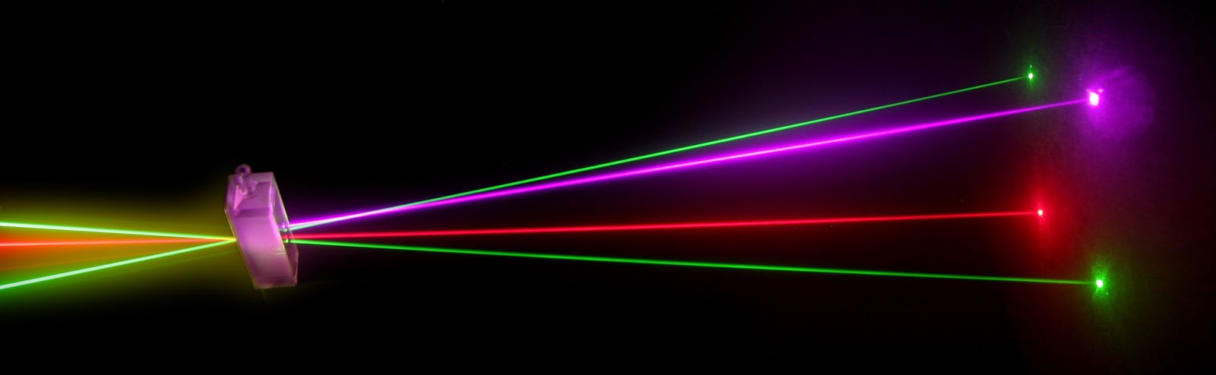
“Laser Technology and Applications”
16B1NPH533
Lecture 19

Slide 2
Lecture 19
Content Outlines
Modes of a Rectangular Cavity and the Open Planar Resonator
The Quality factor

Slide 3
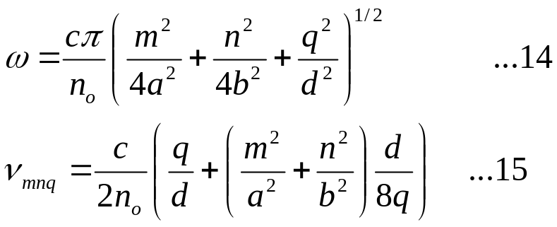
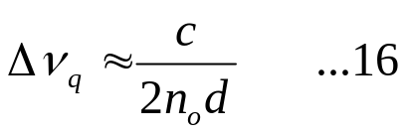
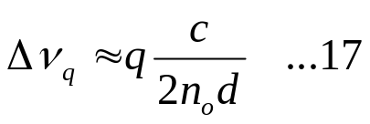
The oscillation frequencies of the various modes of the closed cavity are given by Eq. (14 Lecture-18). In order to obtain an approximate value for the oscillation frequencies of the modes of an open cavity, we may again use Eq. (14) with the condition m,n<<q. Thus making a binomial expansion in Eq. (14) we obtain
The difference in frequency between two adjacent modes having same values of m and n and differing in q value by unity would be very nearly given by
which corresponds to the longitudinal mode spacing. In addition if we completely neglect the terms containing m and n in Eq. (15) we will obtain
The above equation is similar to the frequencies of oscillation of a stretched string of length d.

Slide 4
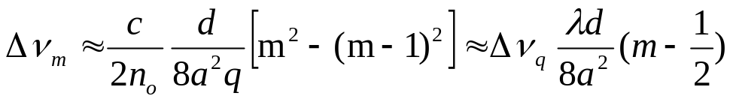
 For a typical laser resonatord∼100 cm and assuming free space filling the cavity, the longitudinal mode spacing comes out to be∼150 MHz which corresponds to a wavelength spacing of approximately 0.18 pm (=0.18×10^{–12} m) at a wavelength of 600 nm.
 Show that the separation between two adjacent transverse modes is much smaller than Δν_{q}.
Solution The frequency separation between two modes differing in m values by unity would be
Where we have used q ≈ 2d/λ . For typical values of λ=600 nm, d=100 cm, a=1cm, λ/d8a²=7.5×10⁻⁴. Thus for m∼1,, Δν_{m} << Δν_{q}.

Slide 5
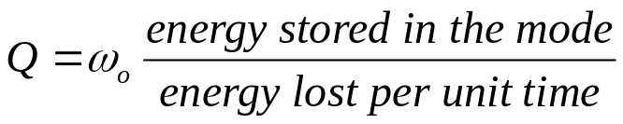
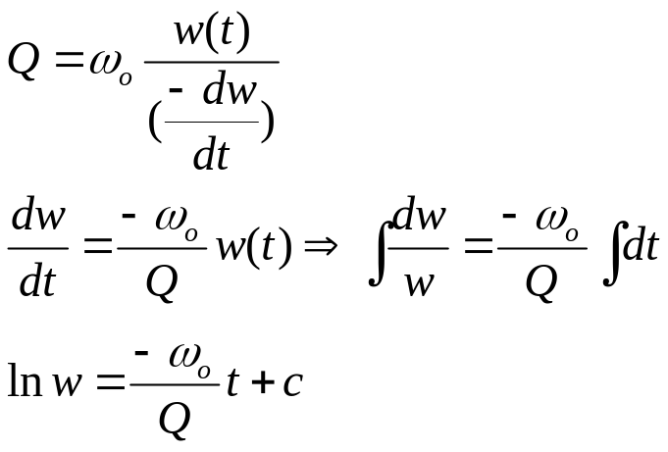
The quality factor:
Q factor is a dimensionless parameter that characterizes the energy dissipation in a resonant system by comparing the time constant of decay of energy to the oscillation period of the system. The smaller the loss the slower would be the decay rate compared to the oscillating period and larger would be the q factor. Q factor of the cavity is defined as
Where ω_{o} is the oscillation frequency of the mode

Slide 6
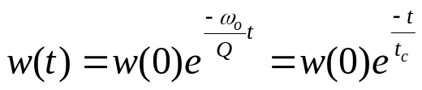
At t=0 let w=w (t=0)=w(0)
Where t_{c}=Q/ω_{o}= Q/2πν_{o}
Is the cavity life time that is the time in which the energy in the mode decrease by the factor of 1/e.
At full width half maximum of the spectrum is
Δν_{p}= ν_{o}/Q
i.e. the higher the quality factor the smaller will be full width half maximum
Lecture 20-Modes.ppt

